Slide 1
COMP 550 Algorithm and Analysis Shortest Path Algorithms Based on CLRS Secs. 22 and 23
Some slides are adapted from ones by Prof. Jim Anderson

Slide 2
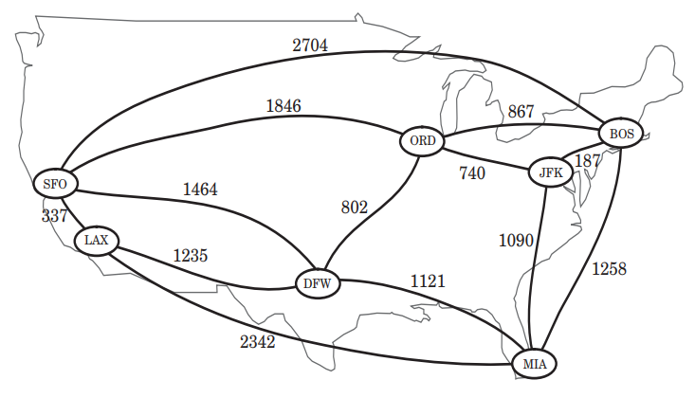
Single-Source Shortest Path (SSSP)
Input: A graph $G=(V,E)$ and a source vertex $v∈V$
Output: Shortest path from $v$ to all other vertices
Source: Algorithm Design and Application by Goodrich and Tamassia

Slide 3
Single-Source Shortest Path (SSSP)
Input: A graph $G=(V,E)$ and a source vertex $v∈V$
Output: Shortest path from $v$ to all other vertices
If $G$is an unweighted graph, then BFS solves the single-source shortest path problem.
What about weighted graph? (this chapter)

Slide 4
Single-Source Shortest Path (SSSP)
There can by different variations:
Single destination shortest path problem: Shortest path to $v$ from all other vertices
Single-pair shortest path problem: Shortest path between a single pair of vertices
All pair shortest path problem: Shortest path between all pair of vertices
All of the above can be solved if we can solve Single-Source version.

Slide 5
Optimal Substructure
Does shortest-path problem have optimal substructure property?
Does shortest path from $u$ to $v$ contain shortest path between some other vertices?
Yes!
Lemma 22.1. (Subpaths of shortest paths are shortest paths)
If $p=⟨v_{0},v_{1},v_{2},…,v_{k}⟩$ is a shortest path from $v_{0}$ to $v_{k}$, then $p_{ij}=⟨v_{i},v_{i+1},…,v_{j}⟩$ with $0≤i≤j≤k$ is a shortest path from $v_{i}$ to $v_{j}$.
Exercise: Does longest path problem have optimal substructure property? (CLRS Sec 14.3)

Slide 6
Optimal Substructure
Lemma 22.1. (Subpaths of shortest paths are shortest paths)
If $p=⟨v_{0},v_{1},v_{2},…,v_{k}⟩$ is a shortest path from $v_{0}$ to $v_{k}$, then $p_{ij}=⟨v_{i},v_{i+1},…,v_{j}⟩$ with $0≤i≤j≤k$ is a shortest path from $v_{i}$ to $v_{j}$.
Proof: ‘’cut and paste’’.
Shortest path from $v_{0}$to $v_{k}$ looks like this
If $p_{ij}$ is not the shortest path between $v_{i}$ and $v_{j}$, then assume $p_{ij}^{′}$ is the shortest path between them.
Using $p_{ij}^{′}$ creates shorter path from $v_{0}$ to $v_{k},$ contradiction. ($p$ is not shortest)
$$p_{0i}$$
$$p_{ij}$$
$$p_{jk}$$
$${ v}_{0}$$
$${ v}_{i}$$
$${ v}_{j}$$
$${ v}_{k}$$
$$p_{0i}$$
$${p′}_{ij}$$
$$p_{jk}$$
$${ v}_{0}$$
$${ v}_{i}$$
$${ v}_{j}$$
$${ v}_{k}$$

Slide 7
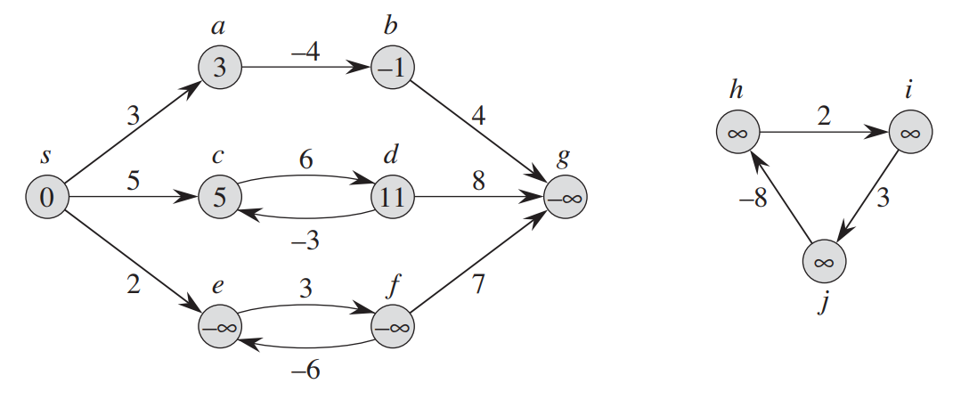
Negative-Weight Edges
Notation: $δ\left(s,u\right)=$Shortest distance from $s$to $v$
$δ\left(s,b\right)=w\left(s,a\right)+w\left(a,b\right)=3+\left(−4\right)=−1$
Source: CLRS
A graph with 11 vertices

Slide 8
Negative-Weight Edges
What is $δ\left(s,c\right)$?
Many paths: $\left\langle s,c\right\rangle ,⟨s,c,d,c⟩$, $\left\langle s,c,d,c,d,c\right\rangle ,…$
Weight of the loop $⟨c,d,c⟩$ is positive.
$δ\left(s,c\right)=$Weight/cost of path $\left\langle s,c\right\rangle =5$
Source: CLRS
A graph with 11 vertices

Slide 9
Negative-Weight Edges
What is $δ\left(s,e\right)$?
Many paths: $\left\langle s,e\right\rangle ,⟨s,e,d,e⟩$, $\left\langle s,e,d,e,d,e\right\rangle ,…$
Weight of the loop $⟨c,d,e⟩$ is negative.
$δ\left(s,e\right)=−∞$ (No shortest path from $s$ to $e)$
Source: CLRS
A graph with 11 vertices

Slide 10
Negative-Weight Edges
$δ\left(s,f\right)=δ\left(s,g\right)=−∞$ (Reachable via a negative-weight cycle)
$δ\left(s,h\right)=δ\left(s,i\right)=δ\left(s,j\right)=∞$(Not reachable from $s)$
Source: CLRS
A graph with 11 vertices

Slide 11
Cycles
Shortest paths do not contain cycles
Negative$−$weight cycle $⇒$ No shortest path
Positive-weight cycle$⇒$ Removing cycle decreases path weight
0-weight cycle $⇒$ Removing cycle maintains the path weight
This represents a cycle not a self-loop
$$u$$
$$x$$
$$v$$

Slide 12
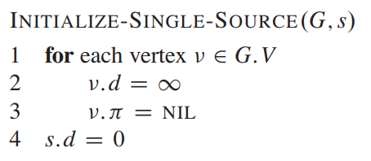
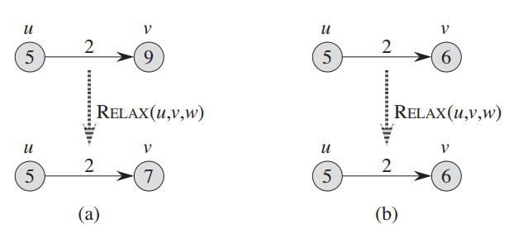
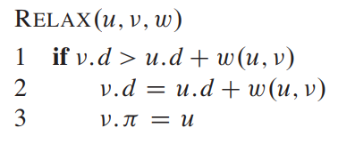
Relaxation
Shortest-path algorithms keep track of $v.d$and $v.π$
$v.d=$shortest-path estimates, $v.π=$ predecessor vertex in shortest path
Will call the following two procedures in different algorithms
Relax edge $\left(u,v\right):$ two cases
Source: CLRS
$(u,v)=$An edge, $w=$weight function

Slide 13
Properties of Relaxation
Consider any algorithm in which $v.d$, and $v.π$ are first initialized by calling $Initialize(G, s)$[$s$ is the source], and are only changed by calling Relax. We have:
Lemma 22.11 (Upper bound property):
(∀ $v$ :: $v.d$ ≥ $δ(s,v)$) is an invariant.
Corollary 22.12 (No-path property):
If there is no path from $s$ to $v$, then $v.d$ = $∞$ is an invariant.
Lemma 22.14 (Convergence property):
If $s u ⟶v$is a SP and $u.d=δ(s,u)$ prior to calling Relax(u,v,w), then $v.d$ = $δ(s,v)$ all time after Relax(u,v,w) is returned
More on CLRS
Exercise: Prove them (Proofs in Sec. 22.5)

Slide 14
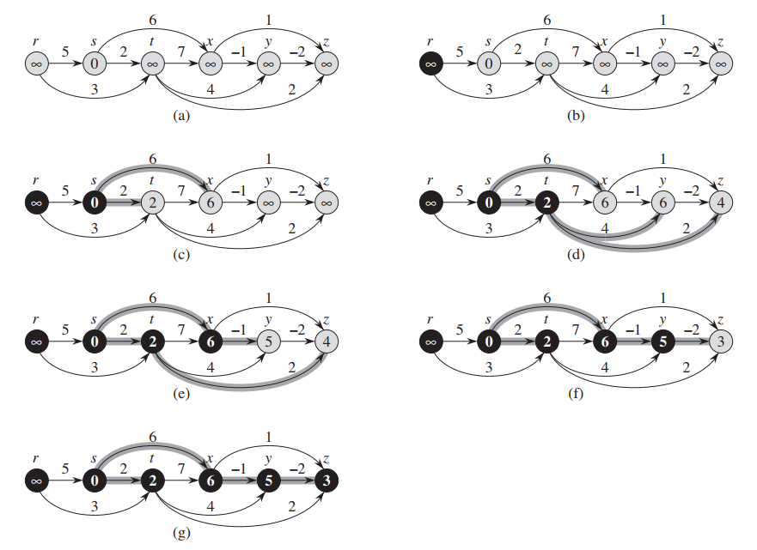
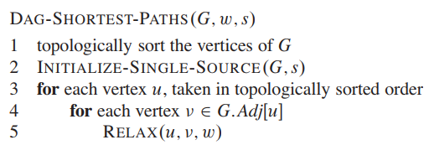
SSSP in DAG
Input graph is a directed acyclic graph
Running time:$Θ(V+E)$
Source: CLRS

Slide 15
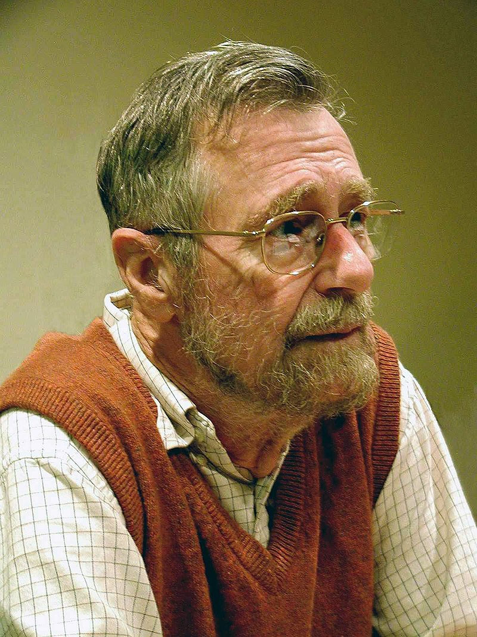
SSSP When Nonnegative-Weight Edge
Input graph is a weighted graph with no negative-weight edge
Dijkstra’s Algorithm finds SSSPs for such graphs
Basically, generalized BFS
Idea: When a node is the closest undiscovered node to the source vertex, we have found its shortest path
“What is the shortest way to travel from Rotterdam to Groningen, in general: from given city to given city. It is the algorithm for the shortest path, which I designed in about twenty minutes. One morning I was shopping in Amsterdam with my young fiancée, and tired, we sat down on the café terrace to drink a cup of coffee and I was just thinking about whether I could do this, and I then designed the algorithm for the shortest path.…One of the reasons that it is so nice was that I designed it without pencil and paper. ….Eventually, that algorithm became to my great amazement, one of the cornerstones of my fame.”
-Edsger Dijkstra (Comm. Of ACM 2001)

Slide 16
Dijkstra’s Algorithm
All vertices are inserted in $Q$
$S$ is the head of $Q$now
$Q$: Min Priority Queue (order by $v.d)$, contains unexplored nodes
Greedy strategy: Extract the head of $Q$ (its shortest distance has been found)
$S$: vertices where we know we’ve found the shortest path. (Like gray nodes in BFS)
Update any shorter distance via node $u$
Source: CLRS

Slide 17
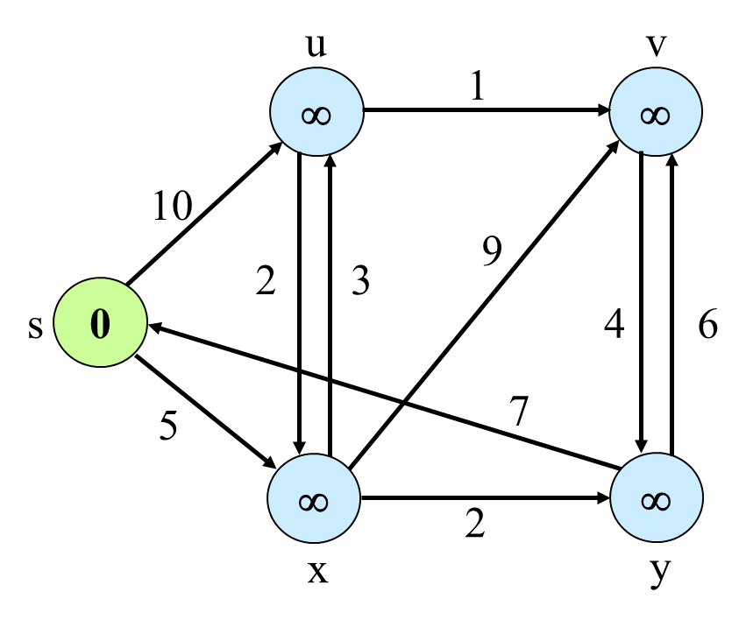
Dijkstra’s Algorithm
Not explored yet
Currently being explored
Already explored
Example Courtesy: Prof. Jim Anderson

Slide 18
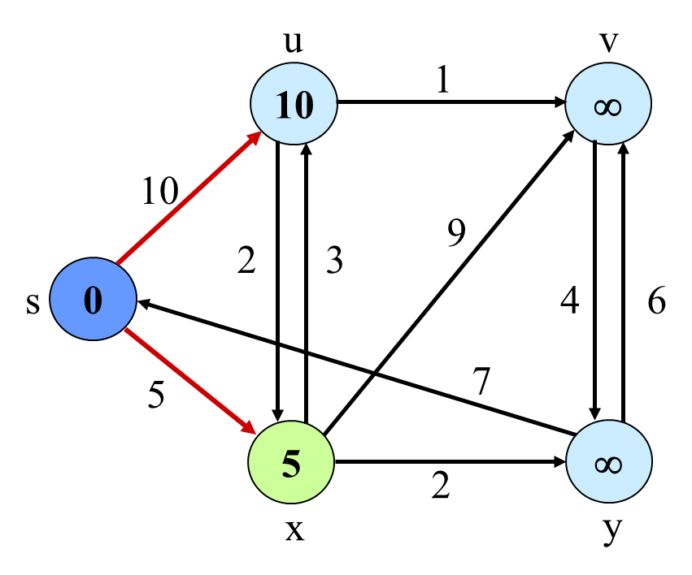
Dijkstra’s Algorithm
Not explored yet
Currently being explored
Already explored
Example Courtesy: Prof. Jim Anderson

Slide 19
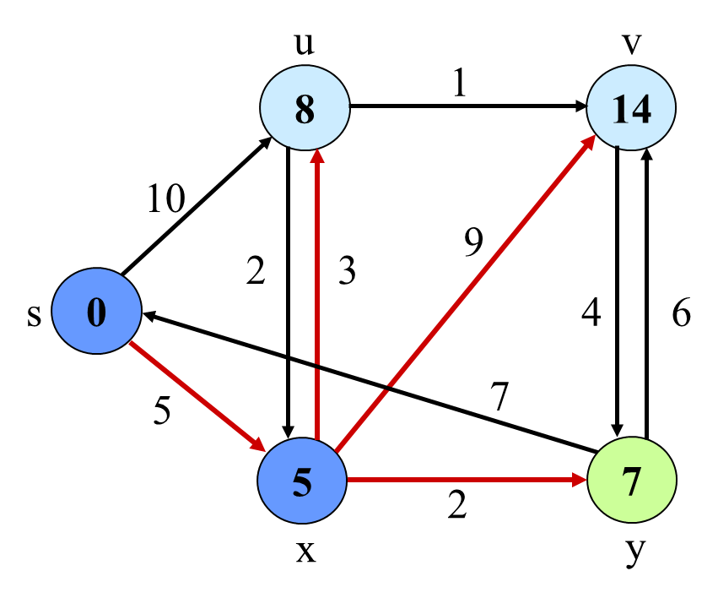
Dijkstra’s Algorithm
Not explored yet
Currently being explored
Already explored
Example Courtesy: Prof. Jim Anderson

Slide 20
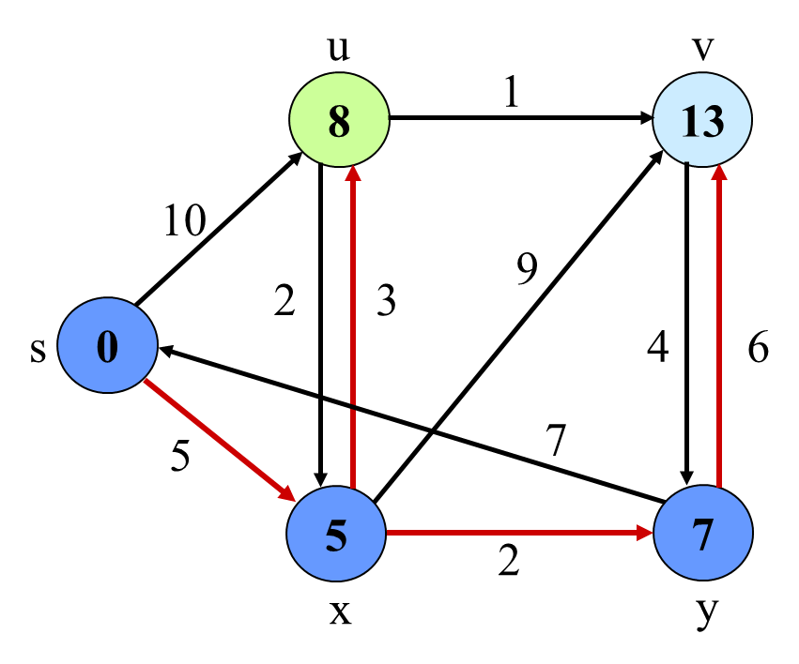
Dijkstra’s Algorithm
Not explored yet
Currently being explored
Already explored
Example Courtesy: Prof. Jim Anderson

Slide 21
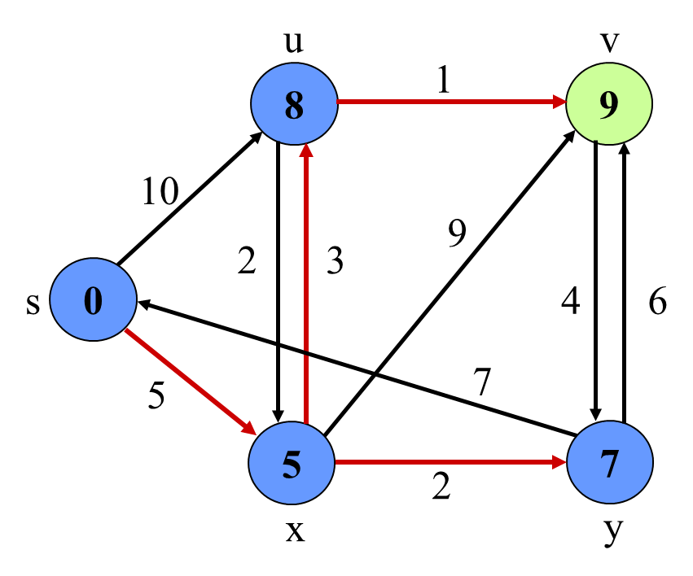
Dijkstra’s Algorithm
Not explored yet
Currently being explored
Already explored
Example Courtesy: Prof. Jim Anderson

Slide 22
Correctness
Theorem 24.6: Upon termination, $u.d$ = $δ(s,u)$ for all $u∈ V$. (assuming non-negative weights).
Loop invariant: At the start of each iteration of the while loop, $v.d=δ(s,v)$ for all $v∈S$. ($S=V$when terminate)
Initialization: $S=∅$(Trivial)
IH: At the start of $k$-th iteration, $u.d$ = $δ(s,u)$ for all $u∈ V$.
Consider the k-th iteration and show that the LI holds at the start of (k+1)-st iteration
The $k$-th iteration inserts a new vertex to $S$
Need to show that the LI holds for the new vertex

Slide 23
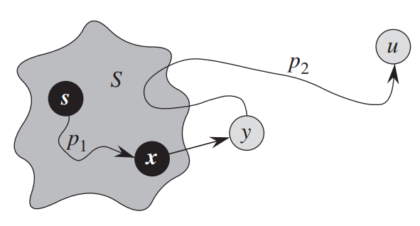
Correctness
Theorem 24.6: Upon termination, $u.d$ = $δ(s,u)$ for all $u∈ V$. (assuming non-negative weights).
Maintenance (Inductive Step):
$u$ is extracted from $Q=V−S$ (our goal is to show $u.d=δ(s,u))$
If no $s$ to $u$ path exists, then $u.d=δ\left(s,u\right)=∞$
Otherwise, let $⟨s,…,x,y,…u⟩$ be a shortest path where
$y$ is the first vertex in the path that is NOT is $S$
$δ\left(s,y\right)≤δ\left(s,u\right),$because no negative edge
$u.d≤y.d$, because $u$is just extracted from $Q$, but $y$ is not.
Using the upper-bound property,
$$δ\left(s,y\right)≤δ\left(s,u\right)≤u.d≤y.d (1)$$
Source: CLRS

Slide 24
Correctness
Theorem 24.6: Upon termination, $u.d$ = $δ(s,u)$ for all $u∈ V$. (assuming non-negative weights).
Maintenance (Inductive Step):
$x.d=δ(s,x)$, because $x∈S$ (by Inductive Hypothesis)
edge $(x,y)$ was relaxed during the loop that added $x$to $S$
Since $(x,y)$ is in a SP from $s$ to $y$ and $(x,y)$ was relaxed when $x.d=δ\left(s,x\right)$, $y.d$gets the value of $δ\left(s,y\right)$ at that time (convergence property: Lemma 22.14).
So, when $u$ is extracted from $Q$, $y.d=δ(s,y)$ already holds.
From (1), we get $u.d=δ(s,u)$
Source: CLRS

Slide 25
Running Time
 | Insert |  |  | Extract-Max |  |  | Decrease-Key |  |  | Total Running Time
 | # calls | Running time per call | Total running time | # calls | Running time per call | Total running time | # calls | Running time per call | Total running time
Node-indexed array | $$O(V)$$ | $$O(1)$$ | $$O(V)$$ | $$O(V)$$ | $$O(V)$$ | $$O(V^{2})$$ | $$O(E)$$ | $$O(1)$$ | $$O(E)$$ | $$O(V^{2})$$
Binary Heap | Use Build-Heap instead of $n$ Inserts |  | $$O(V)$$ | $$O(V)$$ | $$O(\lg{V)}$$ | $$O(V\lg{V)}$$ | $$O(E)$$ | $$O(\lg{V)}$$ | $$O(E\lg{V)}$$ | $$O(\left(V+E\right)\lg{V)}$$
Running time with binary heap is $O(\left(V+E\right)\lg{V), }$which is $O(E\lg{V)}$if $E=Ω(V)$

Slide 26
SSSP with Negative-Weight Edge
Dijkstra’s algorithm fails when there are negative edges
Dijkstra’s algorithm discovers $w$ via $v$. ($w.d$is set to 2).
6
s
u
1
-6
v
w
1

Slide 27
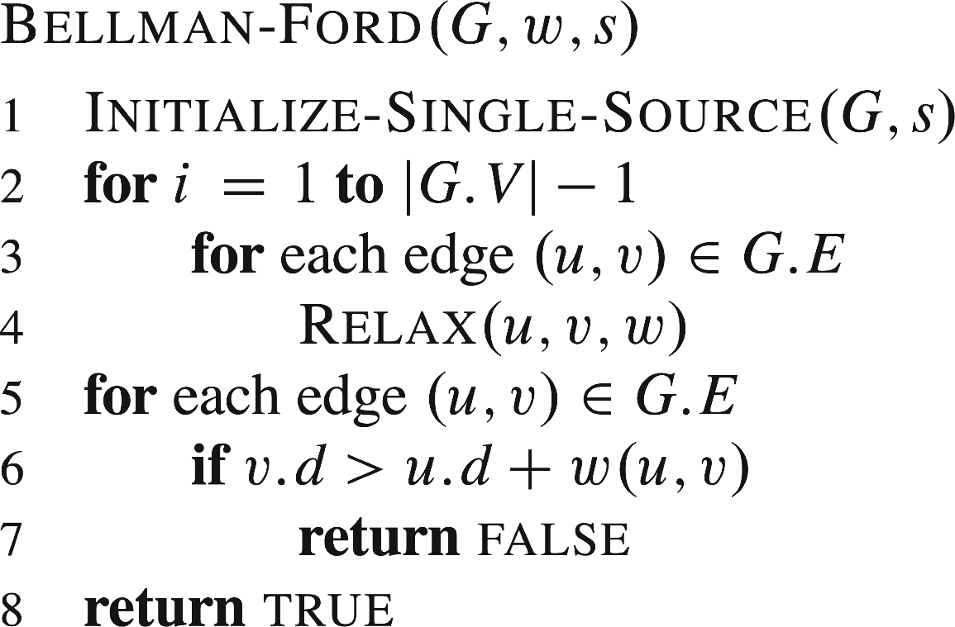
SSSP with Negative-Weight Edge
Bellman-Ford Algorithm
Can handle negative-weight edges and “detect” reachable negative-weight cycles.
Running time:$O(V⋅E)$
Negative cycle exists
Negative cycle detection
No negative cycle
Source: CLRS

Slide 28
Bellman-Ford Algorithm
Loop invariant for the outer for loop:
For every vertex $v$, $v.d≤$ shortest-path length from $s$ to $v$ involving at most $i−1$ edges.
Another Loop invariant for the outer for loop:
For every vertex $v$, if there is a shortest path from $s$to $v$ with at most $i−1$ edges, then$v.d=δ\left(s,v\right).$
Why the outer loop runs $\left|V\right|−1$times?

Slide 29
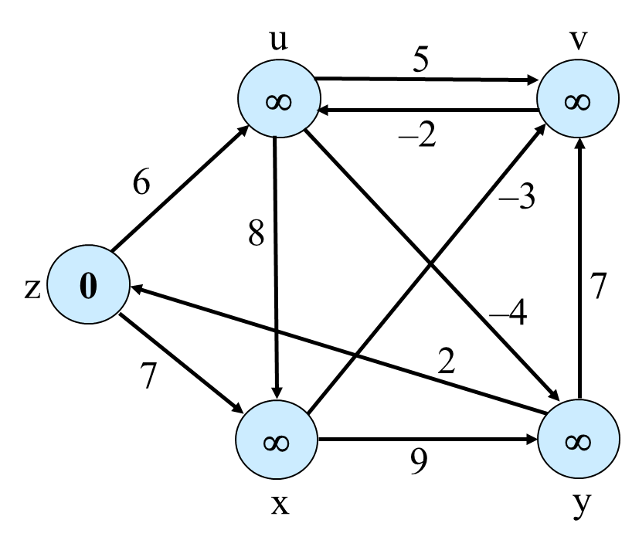
Bellman-Ford Algorithm
Edge ordering: $\left(u,⋅\right), \left(v,⋅\right), \left(x,⋅\right), \left(y,⋅\right), (s,⋅)$
s
Example Courtesy: Prof. Jim Anderson

Slide 30
Bellman-Ford Algorithm
Edge ordering: $\left(u,⋅\right), \left(v,⋅\right), \left(x,⋅\right), \left(y,⋅\right), (s,⋅)$
s
Example Courtesy: Prof. Jim Anderson

Slide 31
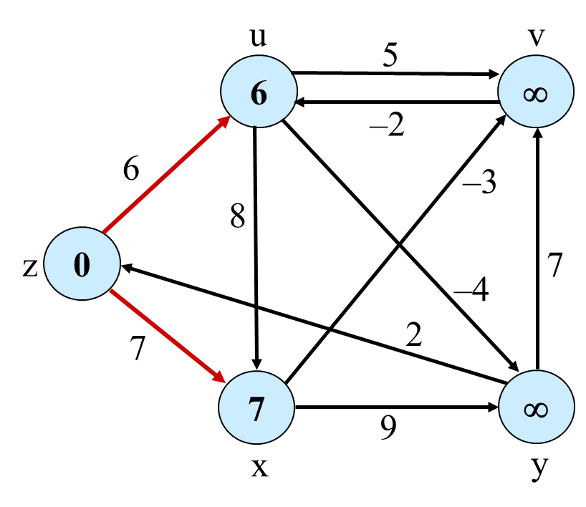
Bellman-Ford Algorithm
Edge ordering: $\left(u,⋅\right), \left(v,⋅\right), \left(x,⋅\right), \left(y,⋅\right), (s,⋅)$
s
Example Courtesy: Prof. Jim Anderson
Red edges denote predecessor relations ($v.π)$

Slide 32
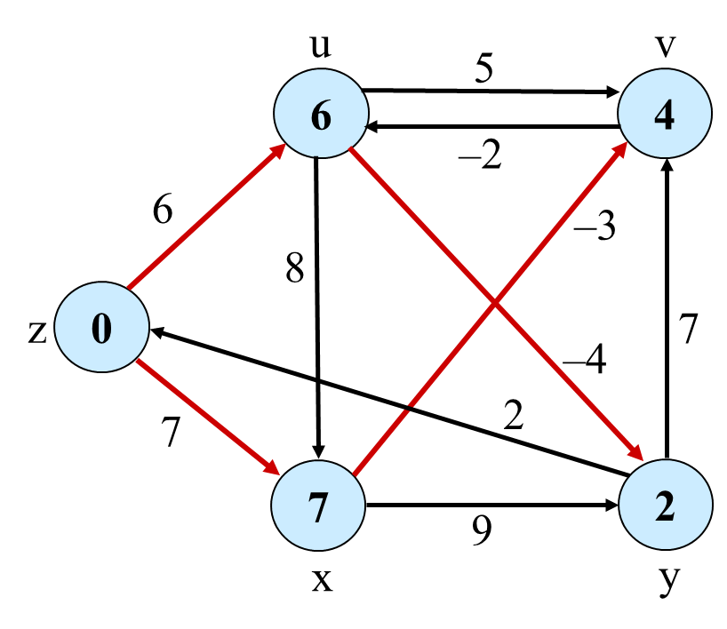
Bellman-Ford Algorithm
Edge ordering: $\left(u,⋅\right), \left(v,⋅\right), \left(x,⋅\right), \left(y,⋅\right), (s,⋅)$
s
Example Courtesy: Prof. Jim Anderson

Slide 33
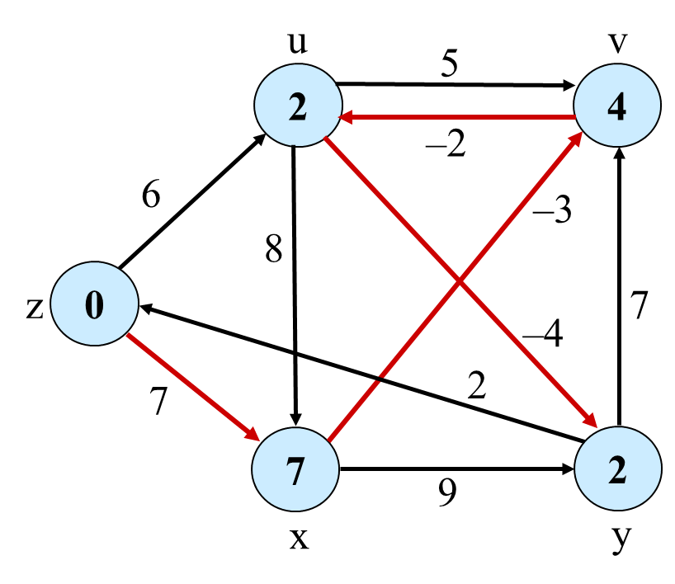
Bellman-Ford Algorithm
Edge ordering: $\left(u,⋅\right), \left(v,⋅\right), \left(x,⋅\right), \left(y,⋅\right), (s,⋅)$
s
Example Courtesy: Prof. Jim Anderson

Slide 34
Bellman-Ford Algorithm
Edge ordering: $\left(u,⋅\right), \left(v,⋅\right), \left(x,⋅\right), \left(y,⋅\right), (s,⋅)$
s
Example Courtesy: Prof. Jim Anderson

Slide 35
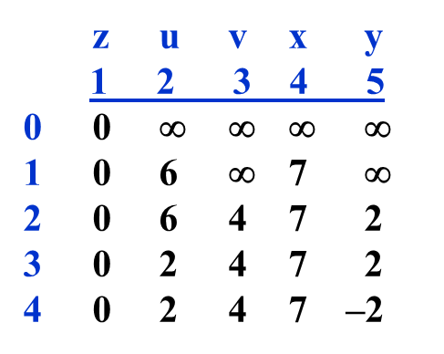
Bellman-Ford Algorithm
The algorithm is based on dynamic programming ideas
$d(v, i) =$ weight of the shortest path from $s$ to $v$ that has at most $i$ hops.
$$0$$
, if $v=s$and $j=0$
$$d\left(v,i\right)=$$
$$∞$$
, if $v≠s$and $j=0$
$$\min{(\left\{d\left(u,i−1\right)+w\left(u,v\right):v∈Adj\left[u\right]\right\}∪d(v,i−1))}$$
, otherwise
s
Note: i-th row is the computed distance after the i-th iteration (depends on edge ordering in the CLRS pseudo-code, a better distance may be computed early)
Table (that is not explicitly stored) for the example graph:

Slide 36
Correctness
A Loop invariant for the outer for loop:
For every vertex $v$, if there is a shortest path from $s$to $v$ with at most $i−1$ edges, then$v.d=δ\left(s,v\right).$
Initialization: $i=1,$only $δ\left(s,s\right)=0$ involves at most 0 edges.
IH: At the start of $k$-th iteration, $v.d$ $=$ $δ(s,v)$ for all $u∈ V$ that has a SP from $s$ involving at most $k−1$ edges.
Maintenance: Assume that a SP from $s$to $v$ has $k$ edges.
Let $u$ be the predecessor of $v$ in this path. (So, a SP from $s$to $u$ has $k−1$ edges)
By IH, $u.d=δ(s,u)$ holds at the start of k-th iteration.
Relaxing edge $(u,v)$ produces $v.d=δ(s,v)$ (Convergence property Lem. 22.14 in CLRS)

Slide 37
Correctness
Lemma 22.2: Assuming no negative-weight cycles reachable from $s$, $v.d$ $=$ $δ(s,v)$ holds upon termination for all vertices v reachable from s.
Since there is no negative-weight reachable cycle, any shortest path from $s$ to $v$ has at most $\left|V\right|−1$ edges.
By the loop invariant, upon termination, if there is a shortest path from $s$to $v$ with at most $|V|−1$ edges, then$v.d=δ\left(s,v\right).$
So, for all reachable $v, v.d=δ\left(s,v\right).$

Slide 38
Correctness
Theorem 22.4: If there is no negative-weight cycles reachable from $s$, then return true, otherwise return false.
See from book

Slide 39
All-Pair Shortest Paths
Application: Computing distance table for a road atlas.
Atlanta Chicago Detroit …
Atlanta - 650 520
Chicago 650 - 210
Detroit 520 210 -

One Approach: Run single-source SP algorithm |V| times.
Nonnegative Edges: Use Dijkstra.
Time complexity:
O(V³) with linear array
O(VElg V) with binary heap
Better approach:
Floyd-Warshall: O(V³), allows negative edges.
Negative Edges: Use Bellman-Ford.
Time Complexity:
O(V²E) = O(V⁴) for dense graphs

Slide 40
Floyd-Warshall Algorithm
Dynamic programming algorithm
$d_{ij}^{(k)}=$ weight of SP from vertex i to vertex j with all intermediate
vertices in the set $\{1, 2, …, k\}$
$$w_{ij}$$
, if $k=0$
$$d_{ij}^{(k)}=$$
$$\min\left\{d_{ij}^{(k−1)},d_{ik}^{(k−1)}+d_{kj}^{(k−1)}\right\}$$
, otherwise
two
possibilities
i
j
i
k
j
all node in {1, …, k–1}
all node in {1, …, k–1}

Slide 41
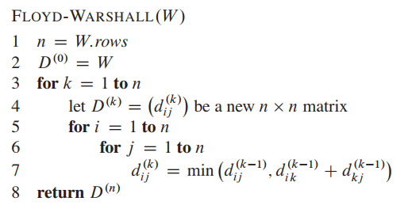
Floyd-Warshall Algorithm
$$δ(i,j) = d_{ij}^{(n)}$$
So, want to compute $D^{(n)}$= $(d_{ij}^{(n)})$.
Exercise:
Run on example graph.
Source: CLRS
Can reduce space from O(V³) to O(V²) — see Exercise 25.2-4.
Can also modify to compute predecessor matrix.

Slide 42
Thank You!

